Slide 1
AUTOSAR Training
Application Software Development
Sagar Madala/Dinesh Dalvi
PowerTrain
Auburn Hills, MI
June 22,2016

Slide 2
Agenda
AUTOSAR Introduction
AUTOSAR Architecture
AUTOSAR Methodology
AUTOSAR SW-C Concepts
AUTOSAR Variant Management
Naming Convention
SystemDesk

Slide 3
AUTOSAR Introduction
www.AUTOSAR.org

Slide 4
AUTOSAR - www.autosar.org
AUTOSAR (AUTomotive Open System ARchitecture) is a worldwide development partnership of car manufacturers, suppliers and other companies from the electronics, semiconductor and software industry.
Paves the way for innovative electronic systems that further improve performance, safety and environmental friendliness
Is a strong global partnership that creates one common standard: "Cooperate on standards, compete on implementation"
Is a key enabling technology to manage the growing electrics/electronics complexity. It aims to be prepared for the upcoming technologies and to improve cost-efficiency without making any compromise with respect to quality
Facilitates the exchange and update of software and hardware over the service life of the vehicle

Slide 5
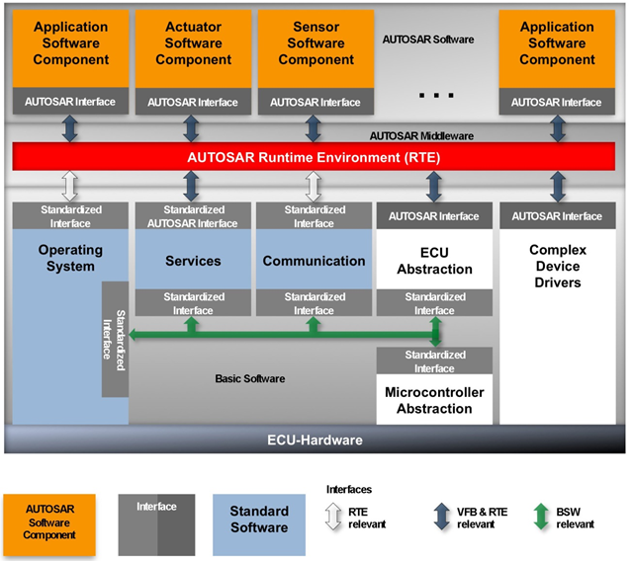
AUTOSAR - www.autosar.org
AUTOSAR is a tool driven methodology and an architecture specification.
Software Components are created in Simulink and auto-coding creates AUTOSAR interfaces.
The Runtime Environment (RTE) is software created by a tool and ties everything together.
The Basic Software (BSW) is created with configuration tools (augmented with hand-coded modules) and provides the infrastructure supporting the hardware.
The AUTOSAR methodology relies heavily upon .xml definition files.
www.autosar.org

Slide 6
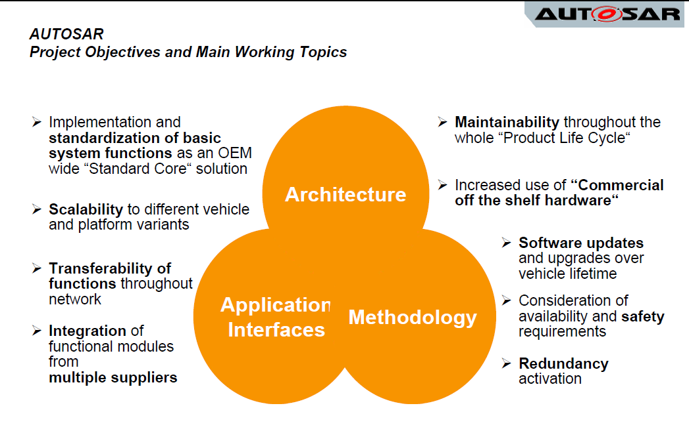
AUTOSAR benefits (from the consortium)
Why AUTOSAR?

Slide 7
Motivation & Goals of AUTOSAR
Motivation
Management of E/E complexity associated with growth in functional scope
Flexibility for product modification, upgrade and update
Scalability of solutions within and across product lines
Improved quality and reliability of E/E systems
Goals
Fulfillment of future vehicle requirements, such as, availability and safety, SW upgrades/ updates and maintainability
Increased scalability and flexibility to integrate and transfer functions
Higher penetration of "Commercial off the Shelf" SW and HW components across product lines
Improved containment of product and process complexity and risk
Cost optimization of scalable systems

Slide 8
AUTOSAR benefits that FCA wants to realize
Formal & Defined Architecture
No Visio drawings that go out of date and are not maintained.
The architecture is modeled in an architectural modeling tool.
The architectural model must always be complete and correct as it is actually a component of code generation (RTE).
Hardware Commoditization
A fully defined AUTOSAR BSW will provide the interface specification necessary to support hardware independence.
Standardization of Inter-department & Supplier Software Interfacing.
The methods for interfacing to suppliers at the software level is standardized.
Still need to do all the same things (interface data, schedule tasks, etc.) but it will be identified through tools.
Functional Safety
Support for ISO26262 – memory protection, end-to-end protection on messages
Safety plans supplied for MCAL and BSW components by the suppliers
Partnering with suppliers that know how to implement certifiable functional safety programs.

Slide 9
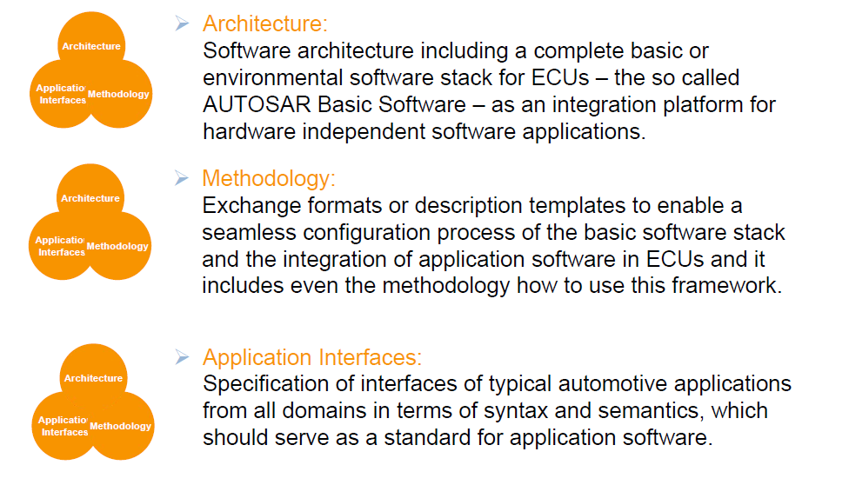

AUTOSAR Main Working Topics

Slide 10
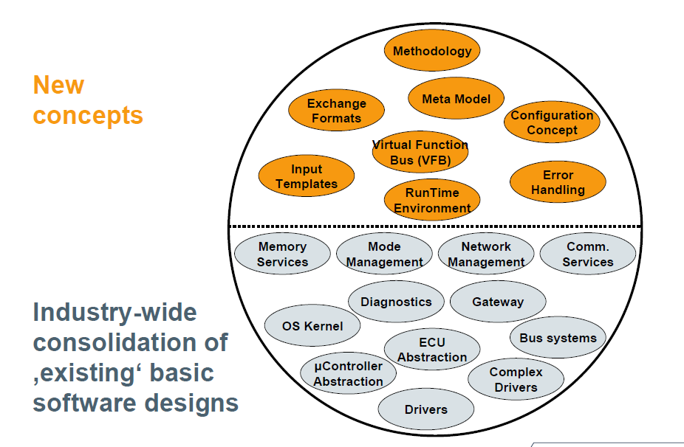
Technical Scope of AUTOSAR

Slide 11
AUTOSAR Architecture Concepts

Slide 12
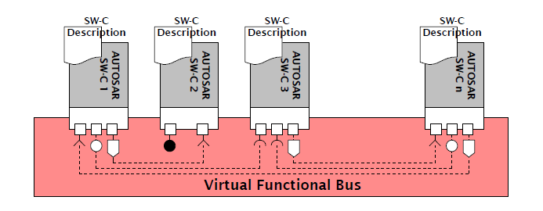
Concepts
Virtual Function Bus (VFB)
is an abstraction of the communication between SW-Cs. It connects different SW-Cs without knowledge of their actual assignment to ECUs, this allows for simpler transferring and integration of SW-Cs.

Slide 13
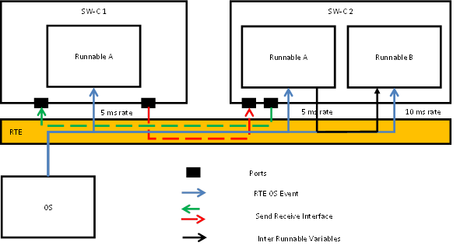
Concepts
Run Time Environment (RTE)
Is the realization of the VFB and provides communication between SWCs
internally (SWCs on the same ECU) and
externally (SWCs on different ECUs).
Decouples the SWC from the underlying BSW (or Foundation), making the SWC independent of the hardware
The RTE is the realization of AUTOSAR interfaces. RTE supports
the communication between SWCs and between SWCs and the BSW
the Scheduling of the SWCs runnables (functions)
RTE is tool generated code and static

Slide 14
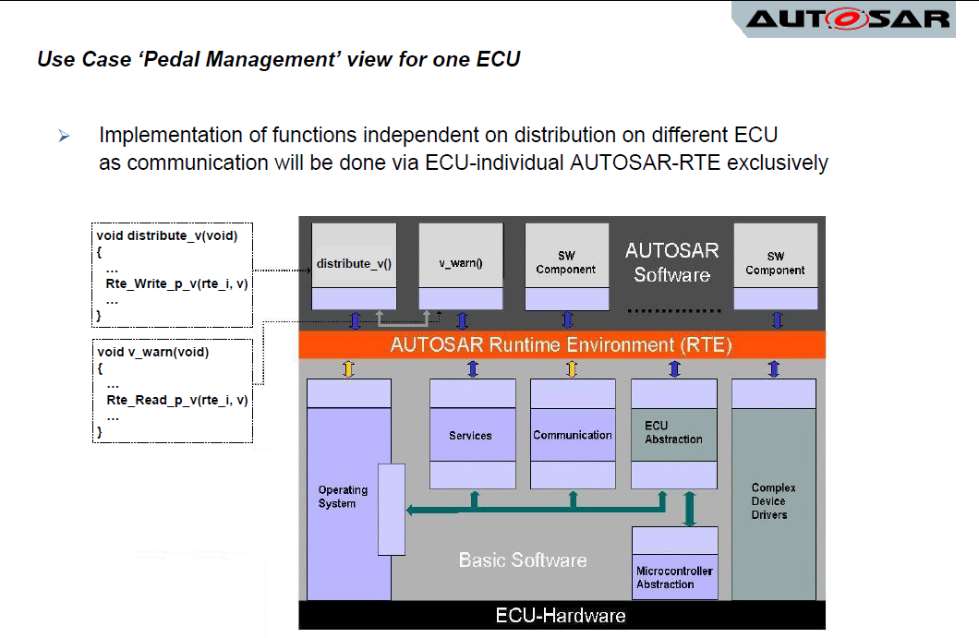

Slide 15
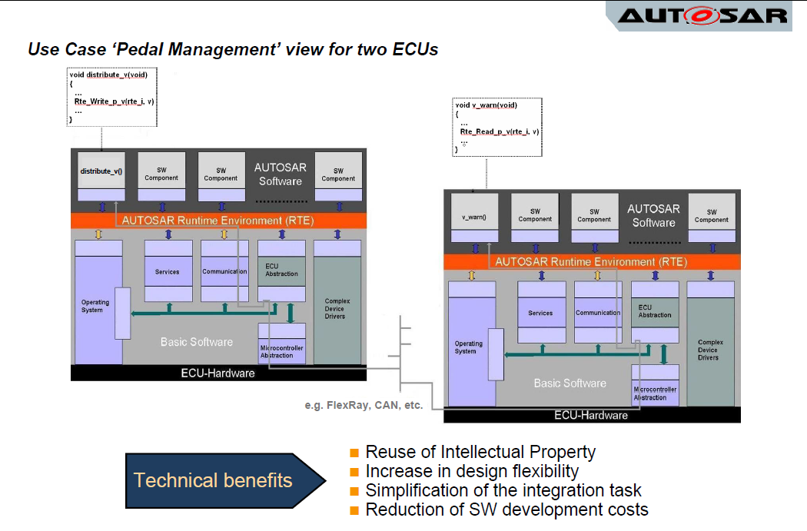

Slide 16
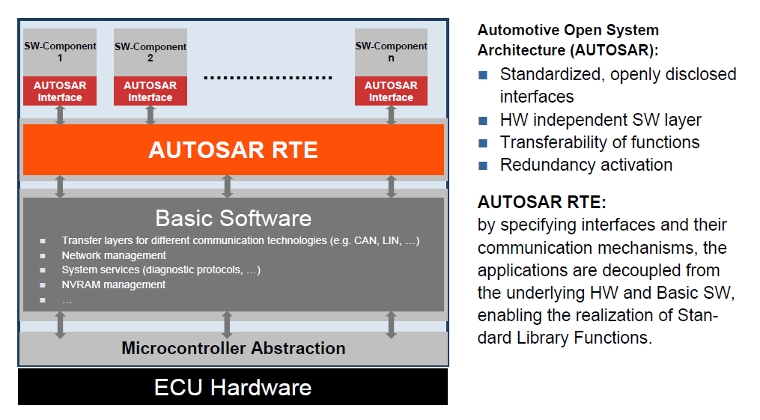
AUTOSAR Layered Architecture

Slide 17
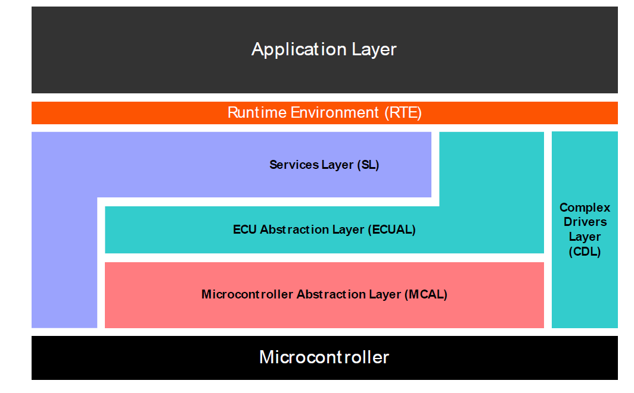

Slide 18
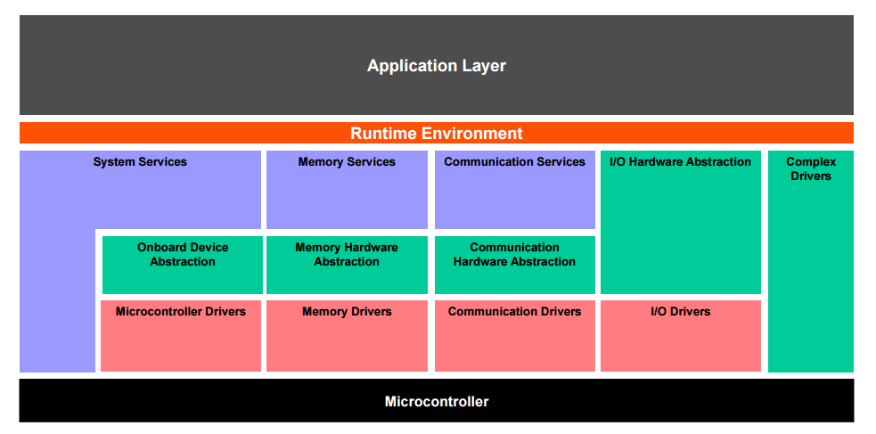
AUTOSAR Layered Architecture

Slide 19
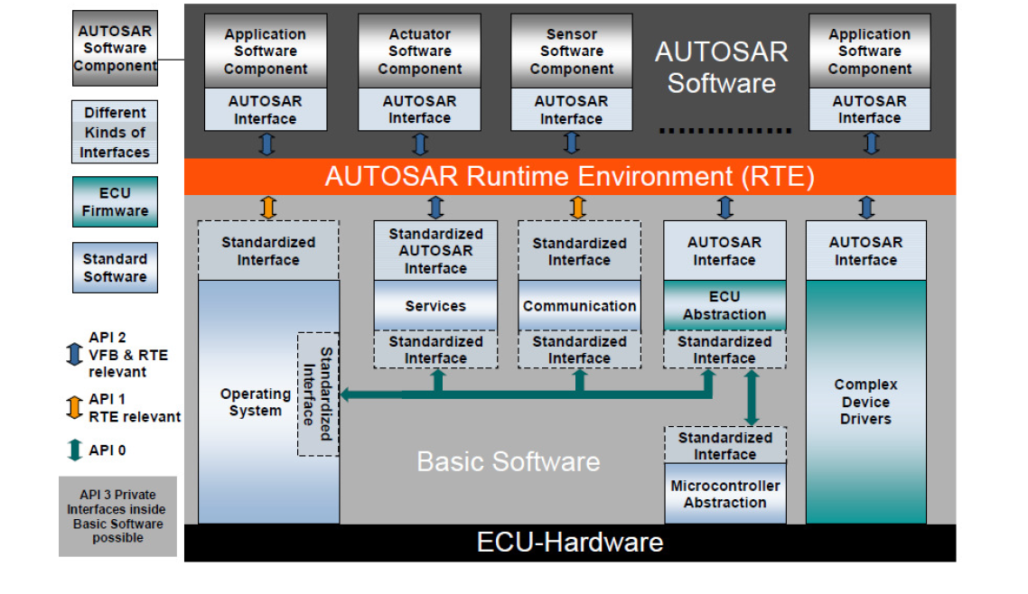
AUTOSAR Layered Architecture

Slide 20
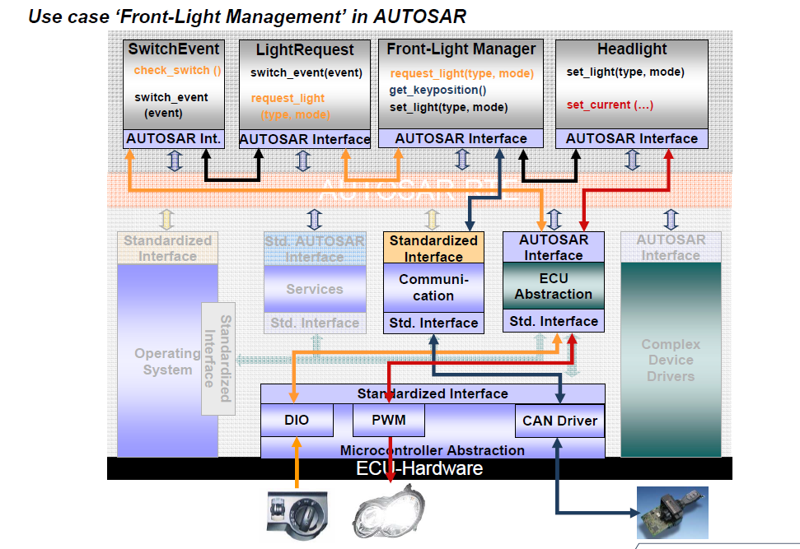
AUTOSAR Architecture Use case – Single ECU

Slide 21
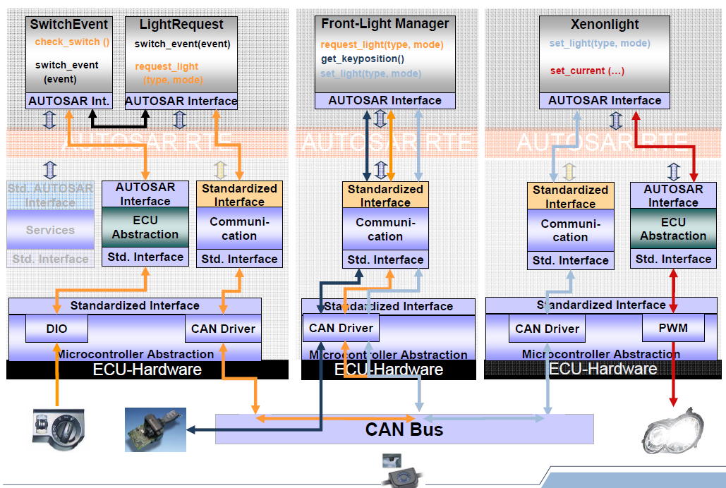
AUTOSAR Architecture Use case – Networked ECU

Slide 22
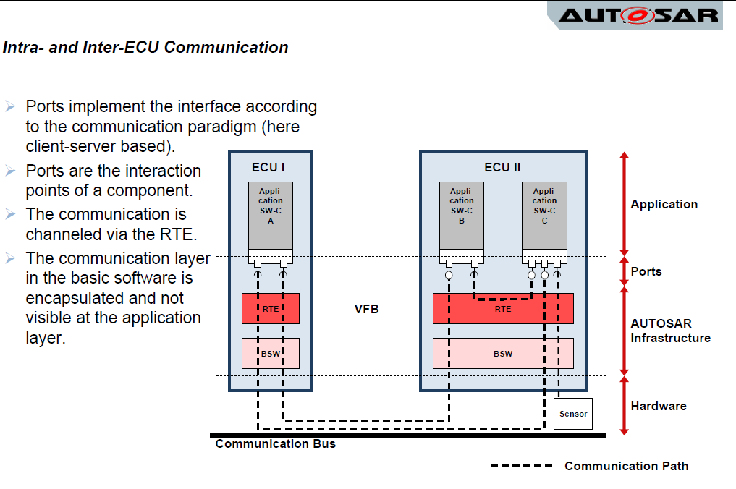
AUTOSAR Architecture Use case – Networked ECU

Slide 23
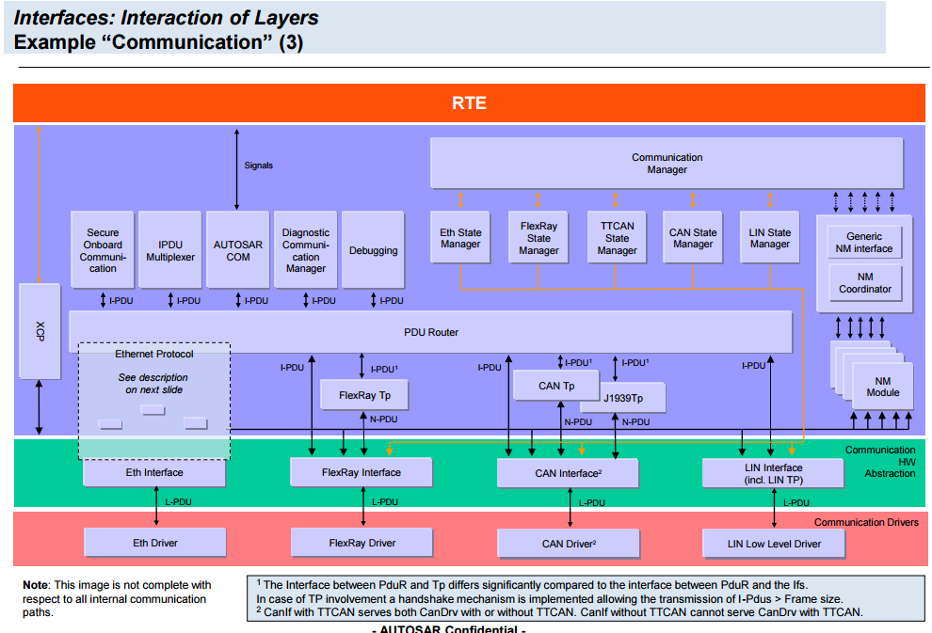
AUTOSAR Communication Layer - Interaction

Slide 24
AUTOSAR Methodology

Slide 25
Methodology
Overall methodology
Structure of configuration information
System Design – Implementation Process

Slide 26
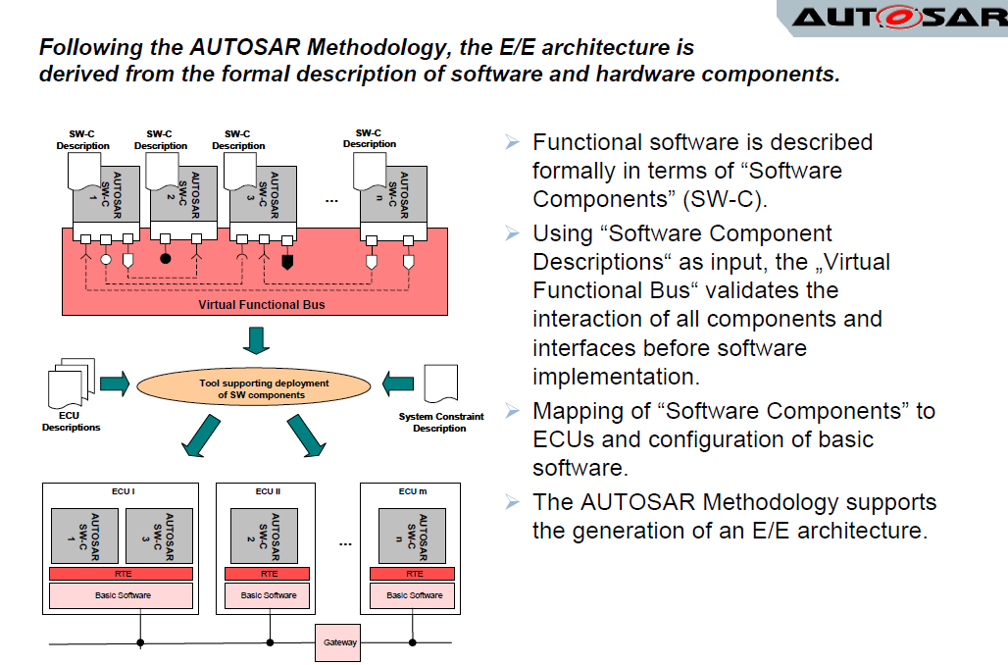
AUTOSAR methodology

Slide 27
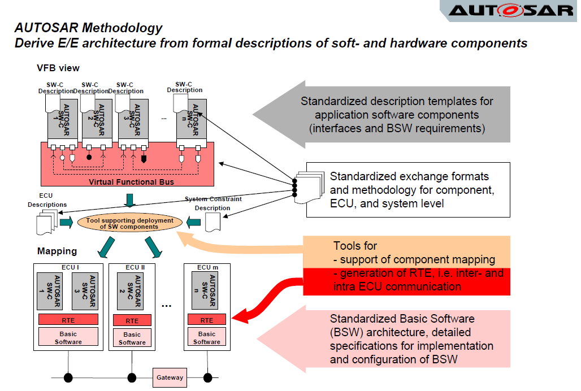
AUTOSAR methodology

Slide 28
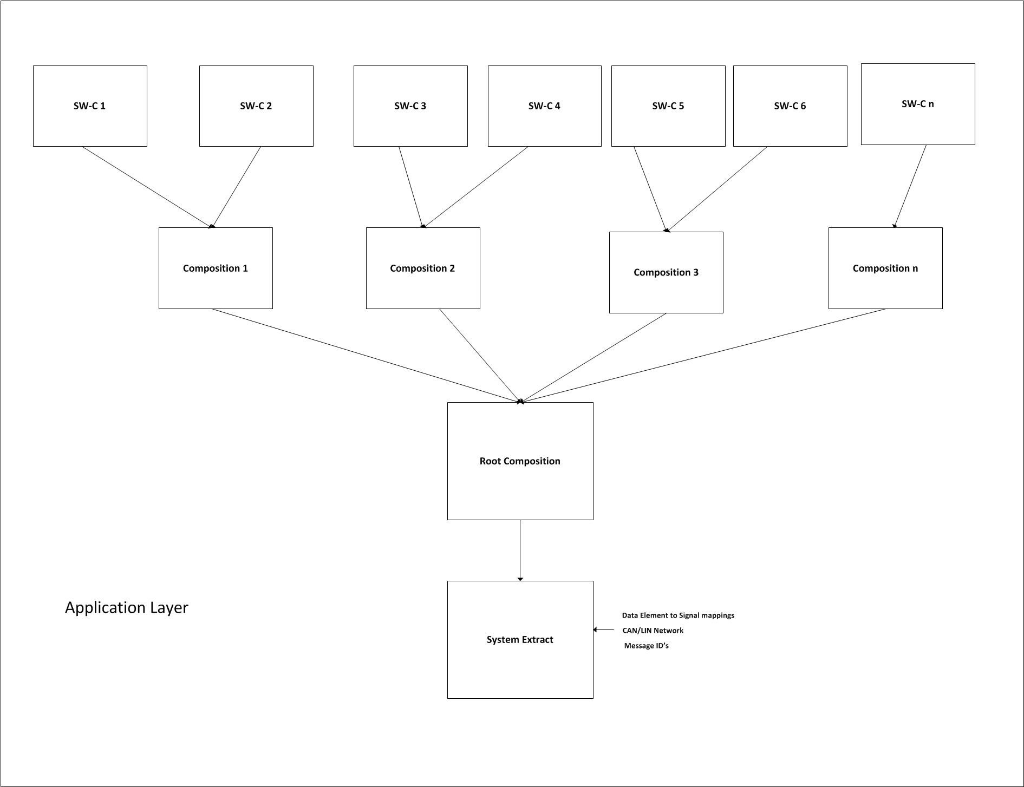
Architecture System Extract

Slide 29
Autosar Workflow - Software Executables
Top Down Approach used
Refer to the attached Document for detailed Workflow

Slide 30
AUTOSAR SWC Concepts

Slide 31
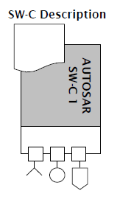
AUTOSAR SWC
The AUTOSAR SWC encapsulate an application which runs on the AUTOSAR infrastructure. The AUTOSAR SWC have well-defined interfaces, to interact with other AUTOSAR SWCs.
SWC Description
For the interfaces as well as other aspects needed for the integration of the AUTOSAR Software Components, AUTOSAR provides a standard description format (SWC Description).

Slide 32
AUTOSAR SWC
AUTOSAR SWC is “atomic” and can’t be split further
Application SW implementation is not specified by AUTOSAR
Application SWC description is specified by AUTOSAR, which influences how SWC is shared
Application SWC is shared as
ARXML (SWC Description)
.c/.obj (SWC Implementation)

Slide 33
AUTOSAR SWC Description
The AUTOSAR SWC Description contains:
The operations and data elements that the software component provides and requires described using the port-interface concept
The resources needed by the software component (memory, CPU-time, etc.),
Information regarding the specific implementation of the software component.
The structure and format of this description is called “software component template”.

Slide 34
Application SWC
Specialized SWCs are used in the AUTOSAR layered architecture.
Following are various type of SWCs

Slide 35
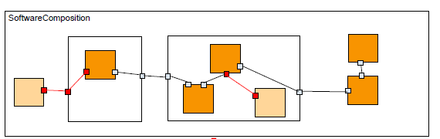
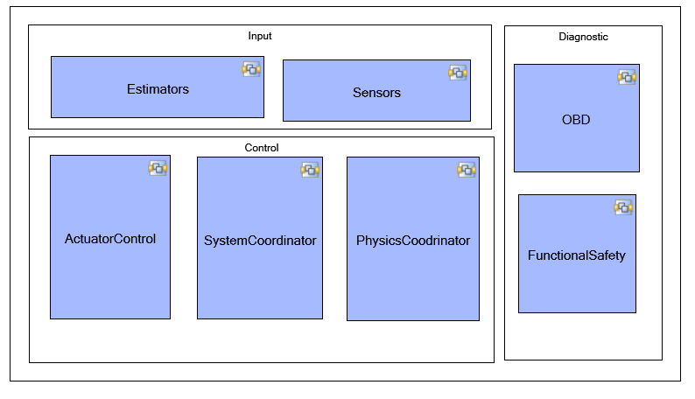
Composition
Composition aggregates SWCs and other compositions.
Composition uses Connectors for primarily
Connecting SWCs among each others and
Towards the surface of the Composition.
By using composition, hierarchical structures of SWCs can be created.

Slide 36
SWC type details
Application SWC: represents the hardware independent application software
Sensor Actuator SWC: software representation of a sensor/actuator to its hardware description provided by the ECU Resource Template
Parameter SWC: defines the shared calibrations of the application software
NvBlock SWC: defines the non-volatile data elements of the application software
Complex Device Driver SWC: has direct access to the hardware resources on an ECU and is therefore linked to a specific ECU or specific hardware
ECU Abstraction SWC: resides between a software-component that wants to access the ECU periphery and the Microcontroller Abstraction
Service Proxy SWC: Provides the ability to express a software-component, which provides access to an internal service for remote ECUs. It acts as a proxy for the service providing access to the service
Service SWC: used for configuring services for a given ECU.

Slide 37
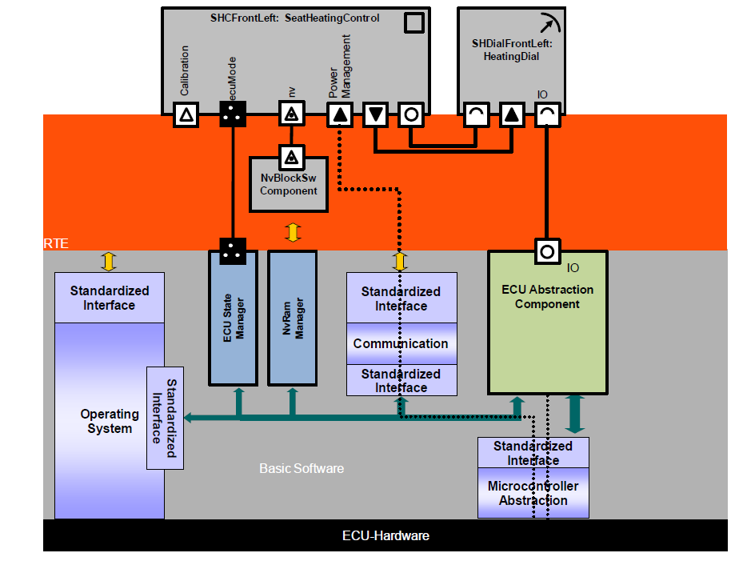
Typical SW-Cs usage in ECU
Complex Device Drivers

Slide 38
SWC description summary
SWC descriptions can be summarized as
Structure
Behavior
Resource

Slide 39
SWC structure
SWC structure is represented using following architecture elements
Ports
Interface
Internal Behavior

Slide 40
Ports
Ports are used to establish connections between SWCs, by assigning interfaces to each port.
Based on the direction of communication, Ports are be classified as
Provided Port – Ports which carry information produced by an SWC to other SWCs
Required Port – Ports which carry information consumed by an SWC from other SWCs
Provided Required - combines the ability to provide and require services or data in within the SWC and across SWCs

Slide 41
Interface
Interface provides means to formally verify structural and dynamic compatibility between software-components.
Interfaces are used to represent the data and control flow
Based on kind of information exchanged between SWCs, following type of interfaces is present
Data Interface : Is an interface which shares data between the SWCs
Client Server Interface : Is an interface which shares operations between the SWCs
Trigger Interface
Mode Switch Interface
NVData Interface: Is an interface used to exchange data between exchanged between NVRAM components and atomic software components

Slide 42
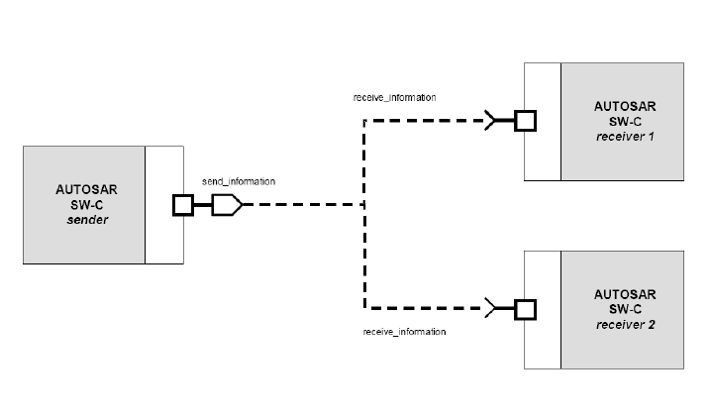
Data Flow Interface
Data flow of the software architecture is represented by sender receiver interface
Data can be any of the following
Volatile Memory (RAM)
Non-Volatile Memory (NVRAM)
Calibration Memory
Following are the types of AUTOSAR Data Interface
SenderReceiver : Volatile Memory Data
NvDataInterface: Non Volatile Memory Data
Parameter Interface: Calibration (limited to calibration shared between the SWC)

Slide 43
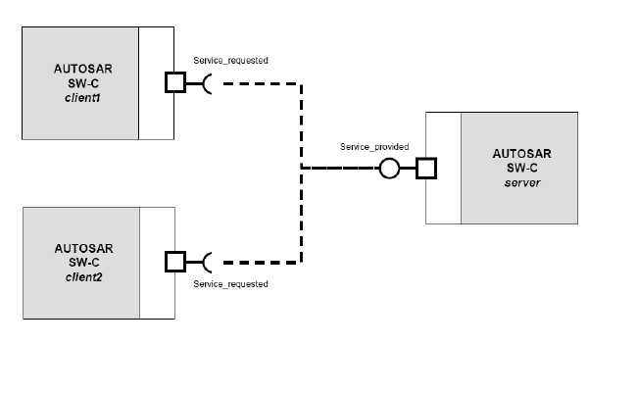
Control Flow Interface
Control flow of the software architecture is represented by the client server interface
Control flow can be any of the following
Library / Utility Function call
Function call between the features
Following are the types of AUTOSAR control flow interfaces
Client – Server interfaces: Library / Utility calls
Trigger Interface : Function call between the features

Slide 44
Behavior
Is represented within the SWC as internal behavior (IB)
IB means for formally defining the behavior of an AtomicSwComponent
IB define the functional behavior of the software architecture and are implemented by a behavior modeling tool such as Simulink.
It is characterized by the following elements
Runnables
SWCs communication
RTE Events

Slide 45
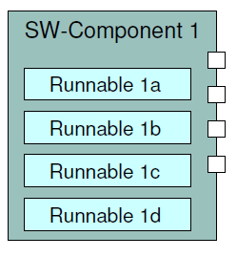
Runnables
A runnable entity is the smallest unit that can be scheduled and executed.
A runnable is collection of various functionalities which needs to be executed together within the SWC
A SWC description provides definitions for each runnable entity within the SWC.

Slide 46
Runnables access
Runnables can respond to data reception or operation invocation on a server
Data Reception
ReadAccess
WriteAccess
Operation invocation
Operation Call (Synchronous or Asynchronous)
Trigger points

Slide 47
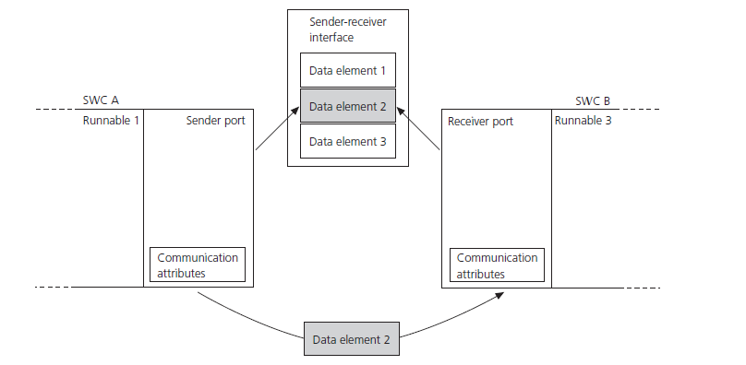
SWCs Communication
Two runnable entities of different atomic software components can communicate with each other and transfer data elements via sender receiver interfaces.
Two type of communication mode exists for Data Transfer
Implicit
Explicit

Slide 48
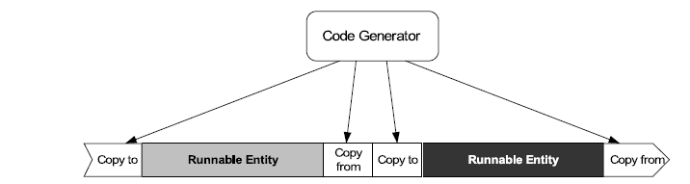
Data Communicate Mode
Implicit
The data is present at the start of the runnable and does not change during the runnable's execution.
The data send operation is done at the return of the runnable.
Additional buffers are required to create data copies
Explicit
Data is exchanged whenever data is required or provided.

Slide 49
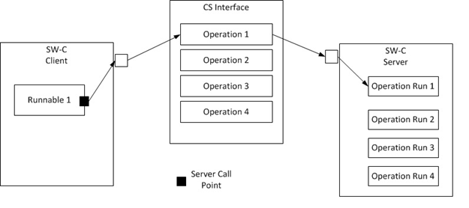
Client Server Communication
In client/server communication a client may initiate the execution of an operation by a server that supports the operation.
The server executes the operation and immediately provides the client with the result (synchronous operation call) or else the client checks for the completion of the operation by itself (asynchronous operation call).

Slide 50
Client Server Communication
A server provides multiple server operations, which are composed in an clientserver interface
Clientserver operation consist of zero to many arguments where arguments can be
passed to the operation (i.e. the direction is “in”)
passed to and returned from the operation (i.e. the direction is “inout”)
returned from the operation (i.e. the direction is “out”)

Slide 51
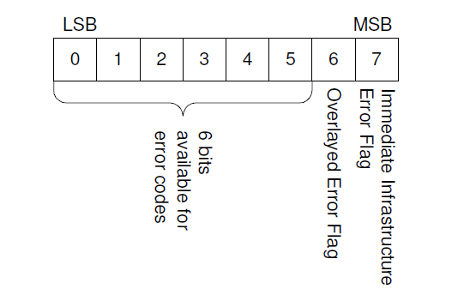
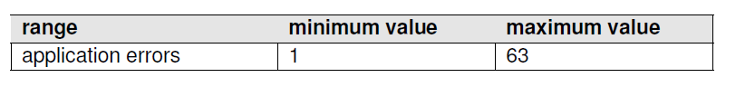
RTE Standard Return
Standard API return type Std_ReturnType
Error Types
Infrastructure Errors
Overlayed Errors (Example – loss of data elements die to queue overflow)
Application Errors

Slide 52
Error Example
Symbolic Name | Value | Comments
RTE_E_OK | 0 | No Error Occurred
RTE_E_INVALID | 1 | Generic application error indicated by signal invalidation in sender receiver communication with data semantics on the receiver side.
RTE_E_COM_STOPPED | 128 | An IPDU group was disabled while the application was waiting for the transmission acknowledgment.
RTE_E_TRANSMIT_ACK | 132 | Transmission acknowledgement received.

Slide 53
Data Communication within the SWC
InterRunnbale Variable (IRV)
Perinstance memory (PIM)
Static Memory

Slide 54
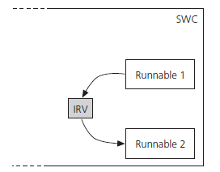
Interrunnables variable (IRV)
IRV communication is communication between the runnables of an atomic software component
Supports concurrent access of data within an SWC by a runnable entity

Slide 55
Perinstance memory
Defines a ’C’ typed memory-block that needs to be available for each instance of the SW-component.
Within the SWC, runnables can access the PIM memory and communicate with each other
An application is responsible for consistency of accessed data by itself.

Slide 56
Static memory
Defines a ’C’ typed memory-block that needs to be available for an SWC.
Static memories are not initiated by the RTE
Within an SWC, runnables can access the static memory and communicate with each other
An application is responsible for consistency of accessed data by itself.
Static memory is restricted for single instantiation of an SWC. For all the multiple instantiations of an SWC, PIM shall be used.
Advantages
Supports needs of functional safety, as SWC is independent of RTE software
SWC internal data details can be shared with suppliers, without any separate documentation

Slide 57
RTE Events
AUTOSAR has defined RTE events for specifying when a runnable entity is triggered.
RTE events are configured to interface with the Operating System.

Slide 58
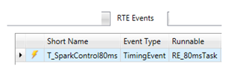
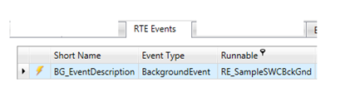
RTE - Triggering events
Timing Event - Trigger a runnable entity periodically at a rate defined within the software-component description. As shown in the example below, a Runnable named “RE_80msTask”, which is to be executed every 80ms is associated with an RTE event named “T_SparkControl80ms”.
Background Event - A recurring RTEEvent which is used to perform background activities. It is similar to a TimingEvent but has no fixed time period and is activated only with low priority. As shown in the example below, a Runnable named “RE_SampleSWCBckGnd”, which is to be executed as a background task is associated with an RTE event named “BG_EventDescription”

Slide 59
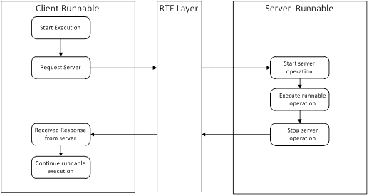
RTE - Triggering events
OperationInvokedEvent - An RTEEvent that causes the RTE to trigger a runnable entity whose entry point provides an implementation for a client-server operation. This event occurs in response to a received request from a client to execute the operation. The figure below represents the client runnable invoking a server operation through RTE interfaces

Slide 60
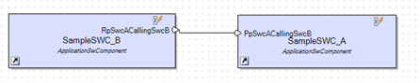
RTE - Triggering events
ExternalTriggerOccurredEvent - A runnable entity triggered by the RTE at the occurrence of an external event. In the example below, a runnable entity named “RunSampleSWC_A” of SampleSWC_A is triggering the runnable entity named “RunSampleSWC_B” of SampleSWC_B

Slide 61
RTE - Triggering events
SwcModeSwitchEvent - Trigger of a runnable entity as a result of a mode switch
AsynchronousServerCallReturnsEvent - Triggers a runnable entity used to “collect” the result and the status information of an asynchronous client-server operation
DataReceiveErrorEvent - Triggers a runnable entity used to “collect” the error status of a data element with “data” semantics on the receiver side.
DataReceivedEvent - A runnable entity triggered by the RTE to receive and process a signal received on a sender-receiver interface
DataSendCompletedEvent - A runnable entity triggered by the RTE to receive and process transmit acknowledgment notifications
ModeSwitchedAckEvent - The event is raised when the referenced modes have been received or an error occurs
DataWriteCompletedEvent - A runnable entity triggered by the RTE to receive and process transmit acknowledgment notifications for implicit communication
InitEvent - A runnable entity triggered by the RTE for initialization

Slide 62
Application SWC Resources
Execution Time
Runnable execution time
Worst Execution Time
Measured execution Time
Memory consumption
Stack Usage
Perinstance memory size (if PIM used)
ROM
RAM

Slide 63
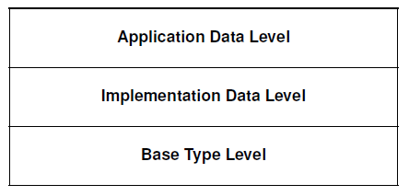
Data Defintions
AUTOSAR support three different levels of data type abstractions
Application data type – defines the data type and its attributes, with respect to the application physical data perspective.
Implementation data type – defines the data type and its attributes, with respect to the actual code implementation in a programming language like C.
Base data type – defines the data type, with respect to the microprocessor/platform, on which the implementation of the implementation data type is done.

Slide 64
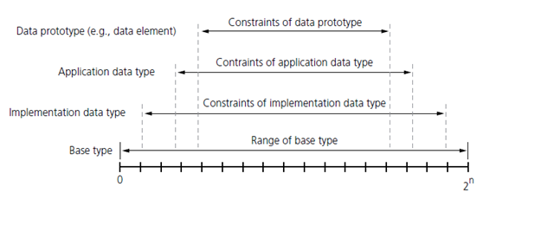
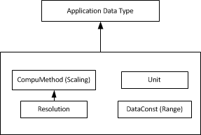
Data Element Representation

Slide 65
Signal – AUTOSAR Data Type mapping

Slide 66
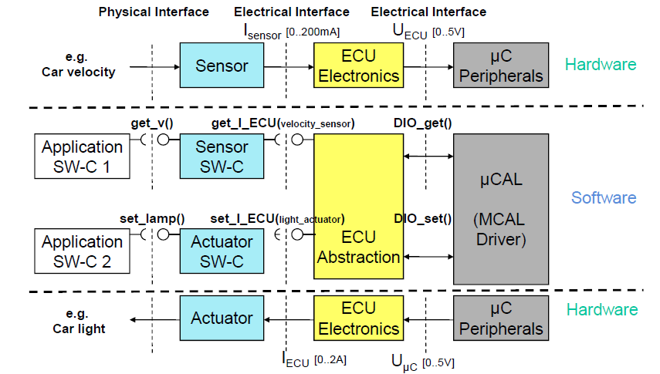
SensorActuator SWC
The SensorActuatorSwComponentType introduces the possibility to link from the software representation of a sensor/actuator to its hardware description provided by the ECU Resource
Signal flow representation is as shown below

Slide 67
Naming Convention
Architecture elements naming language
Short name is dependent on the Signal / functionality names used in the control requirement and behavior model
Description | Use English as standard language to name the SA elements (Short Name and description)
Rationale | Common understanding of names and keywords
Description | The shortname of the SA architecture elements namely Composition, SW-C, Data elements, IRV, PIM, Runnables, Client Server and static memory is named as per the control requirement and behavior model
Rationale | Certain SA elements represent the control signals and functionality and needs to be used in the functional behavior model. The software architecture is important development process between the control architecture and control model. It is important for SA to promote the readability of the control requirements in the control model.

Slide 68
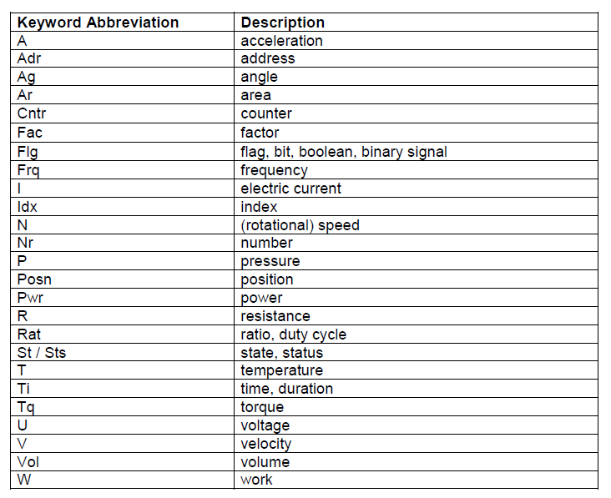
Naming Convention
3. Usage of standardized words in the short name
Description | The Short name of the SA elements is named using the standardized keywords, and shall not have any Architecture specific information
Rationale | The naming convention should allow for names that reflect the purpose of the control functionality. To ease creation of the SA element's short name, predefine standardized keywords can be used. By doing so, naming convention can be standardized. AUTOSAR tool like RTE generator, embeds architectural information with the short name during auto-generation of the SW. So there is no need to include additional architectural information in the short name. Further by having short name with no architecture information, can help in refactoring(partition, merge) the architecture with minimal changes in the name.

Slide 69
AUTOSAR Interface Convention

Slide 70
Naming Convention
4. Usage of the underscore “_”
Note:
_" is not used in the short name.
Trailing "_" shouldn't be used in the short name.
Avoid usage of the sequences of the underscore. Example: 2 continuous underscores "__"
5 . Length restriction for the short name
Description | No underscores shall be used to separate keyword abbreviation used in the shortname
Rationale | As per the AUTOSAR specification, RTE uses underscore to separate AR significant elements. Capital letters can be used to separate the short name abbreviations in the AR element. By standardizing the usage of the "_", compliance of the FCA architecture to AUTOSAR specification can be achieved.
Description | Short name of the AR element is restricted to total length of 8 characters
Rationale | Short names are used in the creation of the C language names. RTE tool generators prefixes to the short names with additional architecture information as per the AUTOSAR specification. By restricting the length of the shortnames, any tool problems can be avoided

Slide 71
Example - Keywords

Slide 72
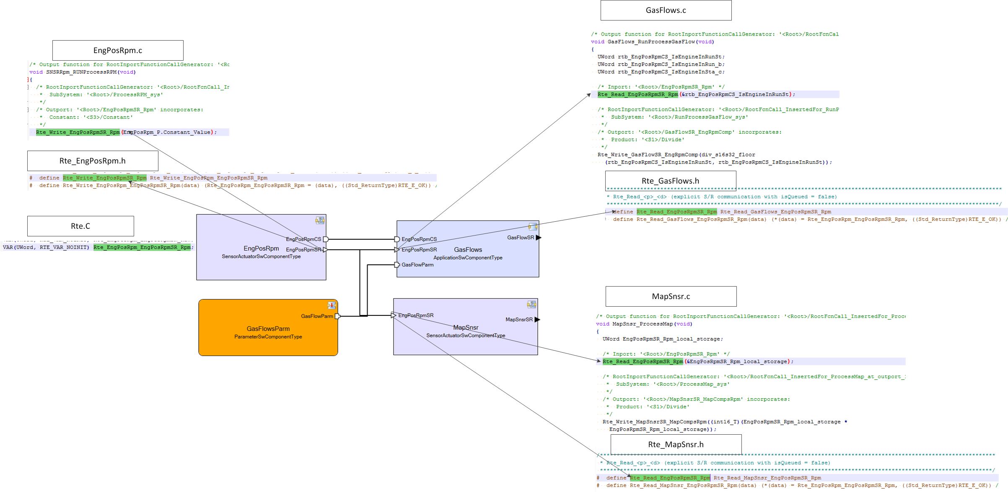
Naming Convention Example

Slide 73
AUTOSAR Variant Management

Slide 74
Autosar Variant Management
Introduction
The motivation for Variant Handling in AUTOSAR is to build a bridge between OEMs and suppliers, to avoid redundancy between artifacts, and to provide a basis for expressing basic product lines in AUTOSAR.
OEMs must manage product features, variability, etc. across their full product line. (Manufacturing, Sales, Engineering, etc.)
Though variant handling concepts do already exist at most companies, they are typically not standardized (beyond company borders), and thus it is difficult for OEM’s and suppliers to talk to each other on this subject.
Scope of Variant Handling Specification In AUTOSAR: we specify only how variations are represented in ARXML. Everything else is implementation specific and not standardized on M2 level.

Slide 75
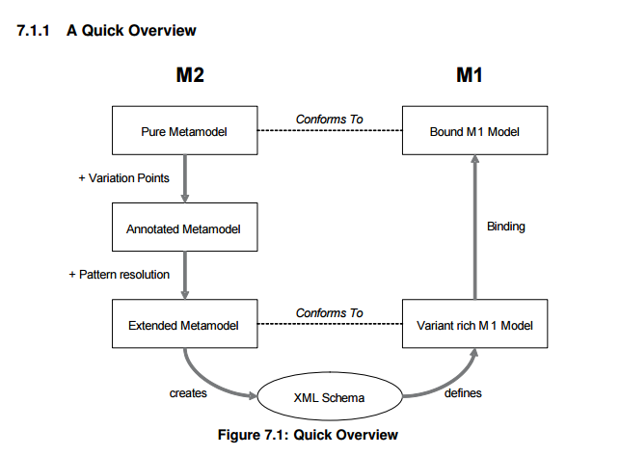
Autosar Variant Management
Key Terms
Variation Points - are locations in the model that are variable. That is, they may not exist in all variants, or may have different characteristics in different variants.
‎Binding Time - is the latest possible time when a variation point may be bound. “Time” is not really a point in time, but rather denotes a phase in the development of an AUTOSAR system.
‎Binding Expressions - specifies under which condition(s) a variable element exists, or determine certain variable characteristics.

Slide 76
Autosar Variant Management
Variationpoints
Variationpointproxy’s
SW Systemconst
SW Systemconstant Value Set
Predefined Variant
Binding options
Supports conditional expressions

Slide 77
Autosar Variant Management
Is the latest possible time when a variation point may be bound.
“Time” is not real a point of time, but rather denotes a phase in the
development of an AUTOSAR system.
The following are the binding times in AUTOSAR
‎Binding Time | ‎AUTOSAR
‎BlueprintDerivationTime | ‎Out of scope
‎FunctionDesignTime | ‎Out of scope
‎InitialBindingTime | ‎No
‎SystemDesignTime | ‎Yes
‎CodeGenerationTime | ‎Yes
‎PreCompileTime | ‎Yes
‎CompileTime | ‎No
‎LinkTime | ‎Yes
‎PostBuild | ‎Yes
‎Runtime | ‎Out of scope

Slide 78
Naming Convention References
Sharepoint
Architecture Naming Convention Summary
AUTOSAR Elements dependency summary

Slide 79
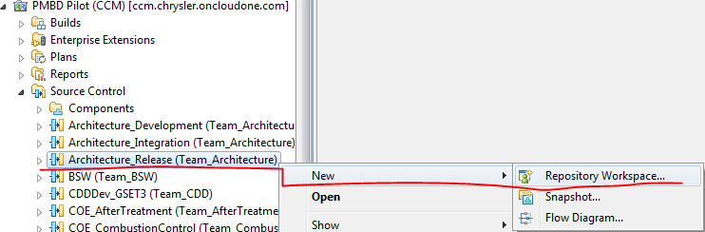
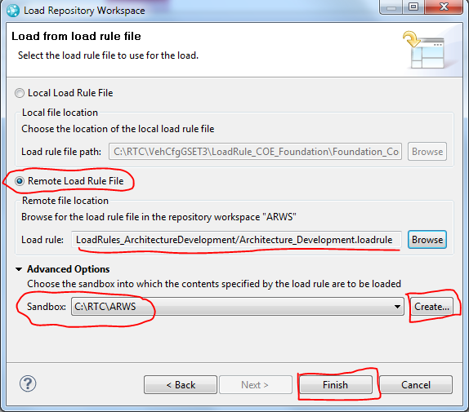
Before SystemDesk
From RTC, Create a Workspace for “Architecture_Release” stream.
Create a Sandbox and load above Workspace using “Architecture_Development.loadrule” and “Arch_Integration_VectorBSW.loadrule”.
Notes:
Streams will change the process remains same.

Slide 80
SystemDesk
Topics
SD Project creation
Import / Export ARXML
AR package hierarchy
Modeling Data Definition
Modeling Interface
SenderReceiver
ClientServer
NV Data Interface
Parameter Interface
TriggerInterface
Modeling SW-C
Ports
Internal Behavior
Runnable
Modeling Composition
Variant Management

Slide 81
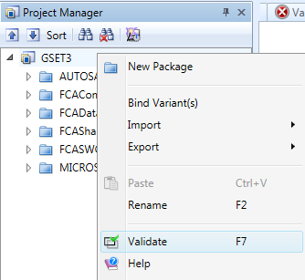
Generic SD Features
SD GUI provides always contextual menu for element selected
Example: For SW-C element, all sub elements of the SW-C is provided in the contextual menu
No “Undo” feature
Rename architecture element
Right click an element, in the contextual menu select rename and enter new name. (Short Cut “F2”)
VALIDATE:
We Shall “Validate” Each and every AUTOSAR
element created/updated. (Short Cut “F7”)
Select Element and press F7 or
Right click and from contextual menu select validate.

Slide 82
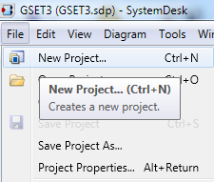
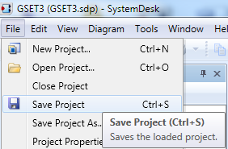
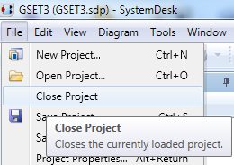
SD Project creation
Open System Desk.
Create new project by clicking
Project is named as per the purpose of the project
Software Component Architecture –<Software Component Name>
Software Composition Architecture –<Composition Name>
Sub System Architecture –<Subsystem Name>
In case multiple features interaction view is required,
it is recommended to use composition views
To Save SD file, select File and click “Save Project”
To close SD File, select File and click “Close Project”

Slide 83
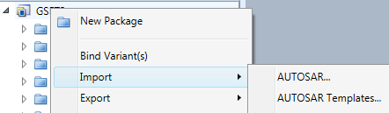

Import / Export
Import ARXML
Right click on the <Project Name>
From context menu select Import -> AUTOSAR
Import ARXML
Select an ARXML files as required

Slide 84

Import / Export
Import ARXML
Select required AR elements from the selection.
Select “Import Diagrams”.
Click “Start Import” to initiate importing of ARXML

Slide 85


Import / Export
Export ARXML
Right click on the AUTOSAR Element, Export -> AUTOSAR
Enter path and File Name, all AR elements will be exported into Target ARXML file
Select right Schema Version, Select right option -> Click Export

Slide 86





Import / Export Using Master File
Export ARXML Import ARXML
Select/Create Path of Mater file you want to Import/Export.
Drag Elements from Unassigned Elements to newly created Masterfile and Write to master file.

Slide 87


AR package hierarchy
To create AR package, a project is required
Within the project, right-click the <ProjectName> project to open its context menu.
In context menu select “AR Package” option to create new AR project.
AR Package structure Rules
Data Definitions
Interface
Features
Composition
Others
SAG Reference: Doors Next Generation- 22911:Software Architecture Guideline

Slide 88
Modeling Data Definition
AR supports application data types for the application SW-Cs development
Scalar - Primitive
Array - Array
Structure - Record
To create an application data type (ADT) following elements are required
Units
SI Physical Dimension (ignored in the training)
Compu Method
Data Constraints
ADT to Implementation Data Type
Note
Implementation Data type (IDT) is made available as part of standard library
IDT’s are
uint8, sint8
uint16, sint16
uint32, sint32
float32, float64
boolean

Slide 89

Modeling Data Definition
Right click on the <Project Name> and import “FCADataDefinition.ARXML”
Right click on the AR package to create new element.
* Do not create new Autosar Element if it already exists.

Slide 90



Modeling Data Definition
Notes:
Vehicle – Base DataType
SUV – Implementation DataType
JEEP – Application DataType

Slide 91
Modeling Data Definition
Base DataType | Implementation DataType | Application DataType
ADTSPhiCtrlClsdLoopDlySec
DCPhiCtrlClsdLoopDlySec
0 -> 163.2
uint8
uint8
SCPhiCtrlClsdLoopDlySec
Offset = 0, LSB = 0.64
Sec
ADTSCylPhiTarWotDlyTmrSec
DCCylPhiTarWotDlyTmrSec
0 -> 5242.8
uint16
uint16
SCCylPhiTarWotDlyTmrSec
Offset = 0, LSB = 0.08
Sec
ADTSFuInjPwMicroSec
DCFuInjPwMicroSec
0 -> 1048560
float32
float32
SCFuInjPwMicroSec
Offset = 0, LSB = 0
MicroSec
Yellow boxes are reusable.

Slide 92

Modeling Data Definition
Units
Right Click on the “Units” AR package
In the context menu, select Unit element as shown below
Create new Unit
Name newly created unit as per the SAG Rule:SAG_R15_DD_M
For time unit name Sec

Slide 93

Modeling Data Definition
Compu Method
Right click on the “CompuMethods” AR Package
In the context menu, select Compu Method element as shown below
Create new Compu Method
Name newly created Compu method as per the SAG Rule:SAG_R15_DD_M
For time with scaling equation H = E/0.64 name “SCPhiCtrlClsdLoopDlySec”

Slide 94

Modeling Data Definition
Compu method
Based on type of scaling select appropriate Category. Following categories are available

Slide 95

Modeling Data Definition
Compu Method
For Linear type, enter Internal to Physical and Physical to Internal equation as per the Control Signal scaling formula

Slide 96

Modeling Data Definition
Data Constraints
Right Click on the “DataConstraints” AR package
In the context menu, select Data Constr element as shown below
Create Data Constraint
Name newly created Data Constraint as per the SAG Rule:SAG_R15_DD_M

Slide 97

Modeling Data Definition
Data Constraints
Double Click to Open Data constraints element, and enter Physical Dimension
For pressure with physical range [0,163.2], update Data Constraint as shown below

Slide 98

Modeling Data Definition
Application Data Type: Scalar Data Type
Right click on the “AppDataTypes” AR Package
In the context menu, select Application Primitive Data Type element as shown below
Create new Application Primitive Data Type
Name newly created ADT as per the SAG Rule:SAG_R15_DD_M
Example: ADTSPhiCtrlClsdLoopDlySec for Sec signal whose range is [0,163.2] with resolution 0.64

Slide 99

Modeling Data Definition
Application Data Type: Associate Data Definition Elements
Double click to Open ADT.
Click “select item from the project” to associate data elements to ADT

Slide 100

Modeling Data Definition
Application Data Type: Array Data Type
Right click on the “AppDataTypes” AR Package
In the context menu, select Application Array Data Type element as shown below
Create new Application Array Data Type
Name newly created ADT as per the SAG Rule:SAG_R15_DD_M
Example: ADTAkPa1 for kPa signal whose range is [0,55] with resolution 0.2

Slide 101

Modeling Data Definition
Application Data Type: Array Data Type
Double click to Open ADT.
Click “select item from the project” to associate primitive data type to array ADT
Set array size as FIXEDSIZE
Enter size of array as required.
Note: Primitive Data Type is required to create any array ADT

Slide 102

Modeling Data Definition
Application Data Type: Record Data Type
Right click on the “AppDataTypes” AR Package
In the context menu, select Application Record Data Type element as shown below
Create new Application Record Data Type
Name newly created ADT as per the SAG Rule:SAG_R15_DD_M
Example: ADTRMapPressureCollection for Map pressure signals bus.

Slide 103

Modeling Data Definition
Application Data Type: Structure Data Type
Double click to Open ADT.
Click “New” to add member of the structure

Slide 104

Modeling Data Definition
Application Data Type: Structure Data Type
Double click to Open ADT.
Click “select item from the project” to associate primitive data type to array ADT
Name newly selected ADT as per the SAG Rule:SAG_R15_DD_M and add member functional definition

Slide 105

Modeling Data Definition
Associate ADT with IDT
Right click on the “AdtToIdtMapping” AR Package
In the context menu, select Data Type Mapping Set element as shown below
Name newly selected mapping set as per the SAG Rule:SAG_R16_DD_M

Slide 106

Modeling Data Definition
Associate ADT with IDT
Double click, mapping set element
Create new mapping entry
Select required ADT and IDT
*Only one ADTtoIDTMapping element is used in a project.

Slide 107
Modeling Interface
AR supports following type of Interfaces
Sender Receiver Interfaces (SR)
Client Server Interfaces (CS)
NVdata Interfaces (NV)
Parameter Interfaces (Parm)
Trigger Interfaces (Trig)
Naming Convention
<SWC Name><Interface Type>
Example: EngPosRpmSR

Slide 108

Modeling Interface
Right click on the <Project Name> and import <SWC>IF.ARXML
Following sub-AR package is created

Slide 109

Modeling Interface
Sender Receiver
Right click on the “IF<SWC Name>” AR Package
In the context menu, select Sender Receiver Interface element as shown below
Name created interface as per the SAG Rule: SAG_R05_IF

Slide 110

Modeling Interface
Sender Receiver
Double click the sender receiver interface.
For all application software owned interface select
Is service option is unchecked
Add description for the interface

Slide 111

Modeling Interface
Sender Receiver: Add Data elements
Click New to add Data Element to Interface

Slide 112

Modeling Interface
Sender Receiver
Double click Data element, and select required ADT/IDT element
Add description as required

Slide 113

Modeling Interface
Client Server
Right click on the “IF<SWC Name>” AR Package
In the context menu, select Client Server Interface element as shown below
Name created interface as per the SAG Rule: SAG_R05_IF

Slide 114

Modeling Interface
Client Server
Double click the sender receiver interface.
For all application software owned interface select
Is service option is unchecked
Add description for the interface

Slide 115

Modeling Interface
Client Server: Add Operation
Click New to add Operation to Interface

Slide 116

Modeling Interface
Client Server
Double click Operation,
Add description as required

Slide 117

Modeling Interface
Client Server
Click New to add new argument

Slide 118

Modeling Interface
Client Server
Name argument as per the control requirement implementation
Add description
Select required ADT/IDT element
Select Direction of arguments (In – Read or Get; Out – Write or Set; Inout – R/W)

Slide 119

Modeling Interface
NV Data Interface
Right click on the “IF<SWC Name>” AR Package
In the context menu, select NV Data Interface element as shown below
Name created interface as per the SAG Rule: SAG_R05_IF
Notes:
NV Team will create NV interfaces for EEPROM
For Flash based NV Application Team shall create NV Interfaces.

Slide 120

Modeling Interface
NV Data Interface
Double click the NV Data interface.
For all application software owned interface select
Is service option is unchecked
Add description for the interface
Note: For EEPROM NV Team will create NV Interface for application to use and for FLASH Application team will create NV Interface.

Slide 121

Modeling Interface
NV Interface: Add Data elements
Click New to add NV Data Element to Interface

Slide 122

Modeling Interface
NV Data Interface
Double click NV Data element, and select required ADT/IDT element
Add description as required

Slide 123

Modeling Interface
Parameter Interface (Shared Calibration)
Right click on the “IF<SWC Name>” AR Package
In the context menu, select Parameter Interface element as shown below
Name created interface as per the SAG Rule: SAG_R05_IF
Note: It Is created for the calibrations shared between the features

Slide 124

Modeling Interface
Parameter Interface (Shared Calibration)
Double click the Parameter interface.
For all application software owned interface select
Is service option is unchecked
Add description for the interface

Slide 125

Modeling Interface
Parameter Interface (Shared Calibration): Add shared calibration data element
Click New to add shared data element to Interface

Slide 126

Modeling Interface
Parameter Interface (Shared Calibration)
Double click parameter element, and select required ADT/IDT element
Add description as required

Slide 127

Modeling Interface
Trigger Interface
Right click on the “IF<SWC Name>” AR Package
In the context menu, select Trigger Interface element as shown below
Name created interface as per the SAG Rule: SAG_R05_IF
Note: Trigger interface created to invoke a runnable between Features
Notes:
Embedded Coder does not Support neither Vector.

Slide 128

Modeling Interface
Trigger Interface
Double click the Trigger interface.
For all application software owned interface select
Is service option is unchecked
Add description for the interface

Slide 129

Modeling Interface
Trigger Interface: Add a trigger element
Click New to add trigger element to Interface

Slide 130

Modeling Interface
Trigger Interface
Double click trigger element,
Add description as required

Slide 131

Modeling SW-C
AR supports various type of SW-C for the system development. Following types are important and relevant for the application SW development
Application SW-C
Sensor Actuator SW-C
NV Component
Parameter component
Right click on the <Project Name> and create new AR package with name “FCASWCs”
Right click on the FCASWCs and create SW-C for each of the features
Notes:
Parameter Component do not have “Internal Behavior”.

Slide 132
Modeling SW-C
To implement a feature architecture following AR elements are required
SW-C
Ports
Ports to Interface Association
Internal Behavior
Runnables
Runnable to Port Association
IRV
Runnable to IRV Association
PIM
Static
RTE Event
Timing
Mode Disabling Dependencies
Mode Switch
Operation Invoked
Init Event
Data Receive Event
Notes:
Static memory Can be used into MATLAB not necessarily define in Architecture

Slide 133

Modeling SW-C
Create Application SW-C
Right click on the “FCASWCs” AR Package
In the context menu, select Application SW Component Type element as shown below
Name created Application SW-C as per the SAG Rule: SAG_R29_PC_M

Slide 134

Modeling SW-C
Create Sensor Actuator SW-C
Right click on the “FCASWCs” AR Package
In the context menu, select Sensor Actuator SW Component Type element as shown below
Name created Sensor Actuator SW-C as per the SAG Rule: SAG_R29_PC_M

Slide 135

Modeling SW-C
Create NV Block SW-C
Right click on the “FCASWCs” AR Package
In the context menu, select NV Block SW Component Type element as shown below
Name created NV Block SW-C as per the SAG Rule: SAG_R29_PC_M

Slide 136

Modeling SW-C
Create Parameter SW-C
Right click on the “FCASWCs” AR Package
In the context menu, select Parameter SW Component Type element as shown below
Parameter SWC does not contain Internal behavior.
Name created Parameter SW-C as per the SAG Rule: SAG_R29_PC_M

Slide 137


Modeling SW-C
Create Internal Behavior
Right click on the SW-C element
In the context menu, select SWC Internal Behavior element as shown below
Name created Internal Behavior as per the SAG Rule: SAG_R29_PC_M

Slide 138

Modeling SW-C
Create Ports
Right click on the SW-C element
In the context menu, select required type of port element as shown below
Following consideration is required to select right port type
INPUT – Required Port Prototype
OUTPUT – Provided Port Prototype
INPUT/OUTPUT – Provided Required Port Prototype
Examples: NV Data Ports, Outputs which are used internally at multiple runnables
Notes:
PR Port Examples. NV Data or Output used in multiple runnables

Slide 139

Modeling SW-C
Create Ports
Initialize Port Interface Data element with an Init value
In “Provided Com Specs”, update Init value is required

Slide 140

Modeling SW-C
Create Ports
Name ports as per the SAG_R07_PC_M
Following needs to be considered
Add Producing SWC name and interface type abbreviation associated with the port

Slide 141

Modeling SW-C
Interface – Port Mapping
Identify the interface which needs to be associated with the port
Select the interface, drag and drop on the port to be associated
Note
Only one interface can be associated with a port
If an interface is both IN / OP use “Provided Required Port Prototype” (PR)

Slide 142

Modeling SW-C
Create Runnable
Right click on the IB<SWC Name> element
In the context menu, select Runnable Entity element as shown below
Name runnable appropriately.

Slide 143

Modeling SW-C
Runnable To Ports Association
Double click runnable element
Select Data Access Tab
Click select and check required Data element of an interface

Slide 144
Modeling SW-C
Data Elements are accessed in runnable using Implicit/Explicit Data Access type.
Implicit Data Access:
RTE maintains coherency of Data among different OS tasks.
RTE Creates copy of variable per OS task (which is accessing data).
Excessive RAM usage
Access/Direction: Read, Write shall be configured in System Desk.
Explicit Data Access:
RTE does NOT maintain coherency of Data.
Creates local variable inside runnable.
Excessive Stack usage.
Access/Direction: Receive By Argument, Send shall be configured in System Desk.
*Note: Prefer Explicit Access unless absolute necessary of Implicit Access.

Slide 145

Modeling SW-C
Runnable To Ports Association
Select required “Access/Direction” for each selected Data Element
For Provided Required Ports Data element will be selected twice one for Read and Write
For explicit communication
Use “Receive by argument “ for all Read operation
Use “Send” for all Write operation
Notes:
We need to Explain Implicit and Explicit Communication and what are the options in system desk to select either of them.

Slide 146

Modeling SW-C
Create IRV
Double click Internal Behavior element
Select Interrunnables Tab
Select Explicit/Implicit and click New

Slide 147

Modeling SW-C
Create IRV
Double click new IRV variable element
Perform following
Create new shortname
Add Description
Select ADT/IDT
Add and create new Init Value

Slide 148
Modeling SW-C
Runnable To IRV Association
Double click runnable element
Select Data Access Tab
Click select and check required IRV

Slide 149

Modeling SW-C
Runnable To IRV Association
Select required “Access/Direction” for each selected IRV Element

Slide 150

Modeling SW-C
Create PIM
Double click Internal Behavior element
Select Per Instance Memory Tab
Click New to create new PIM
Notes:
Embedded Coder doesn’t support multiple instantiation So PIM is not useful at this moment.

Slide 151
Modeling SW-C
Create PIM
Create new short name
Update description
Select ADT/IDT for PIM
Update Init Value based on the ADT/IDT type (Scalar, Array or record)

Slide 152

Modeling SW-C
Create Static memory
Double click Internal Behavior element
Select “Advanced” Tab
Click New to create new Static Memory

Slide 153
Modeling SW-C
Create Static Memory
Create new short name
Update description
Select ADT/IDT for Static Memory
Is SWC is instantiated more than once, static memory can’t be used.

Slide 154

Modeling SW-C
Create RTE Event
Double click Internal Behavior element
Select RTE Events Tab
Select type of Event required
Click New
Name RTE event as per the SAG rule: SAG_R40_PC_M

Slide 155

Modeling SW-C
Create RTE Event
Double click RTE event
Perform following
Update shortname
Update period
Select runnable which need the RTE event

Slide 156

Modeling SW-C
Mode Disabling Dependency
For Timing event click on Mode Disabling Dependencies tab
Select modes where assigned runnable shall NOT be executing.
*Note: All timing events shall be disabled in SHUTDOWN mode.

Slide 157

Modeling SW-C
Mode Switch Event
Double click Internal Behavior element and Select RTE Events Tab
Select type of Event required, Click New

Slide 158

Modeling SW-C
Mode Switch Event
Double click RTE event
Perform following
Create shortname
Select runnable which need the RTE event
Select Exited mode and Entered mode to create Mode transition event

Slide 159


Modeling SW-C
Modeling Server Operation
Create “Provided” CS Port interface in the Server component as
Create Operation runnable
Right click on the IB<SWC Name> element
In the context menu, select Runnable Entity element as shown below
Name of Server Runnable Operation shall have same name as provider operation.

Slide 160

Modeling SW-C
Create RTE Operation invoked Event
Double click Internal Behavior element
Select RTE Events Tab
Select “Operation Invoked” Event
Click New
Name RTE event as per the SAG rule: SAG_R40_PC_M

Slide 161

Modeling SW-C
Associate RTE Operation invoked Event with Runnable
Double click “Operation invoked Event” element
Select “Start of ref”
Select “Runnable” to be associated with the event

Slide 162

Modeling SW-C
Create RTE Init Event
Double click Internal Behavior element
Select “Init Event” in RTE Events Tab
Select Click New
Name RTE event as per the SAG rule: SAG_R40_PC_M

Slide 163

Modeling SW-C
Associate RTE Init Event with Runnable
Select Start on event ref.

Slide 164

Modeling SW-C
Create RTE Data Receive Event
Double click Internal Behavior element
Select “Data Receive Event” in RTE Events Tab
Select Click New
Name RTE event as per the SAG rule: SAG_R40_PC_M

Slide 165

Modeling SW-C
Associate RTE Init Event with Runnable
Select Start on event ref.
Select Data Element on reception of which event shall be generated.

Slide 166

Modeling Composition
Right click on the <Project Name> and import FCAComposition ARXMLs.
Right click on the FCAComposition and create Composition
Add additional non AUTOSAR graphical details as required

Slide 167

Modeling Composition
Create Composition Type
Right click AR package
From the context menu select Composition SW Component type element
Name composition as required

Slide 168

Modeling Composition
Create Composition
Right click composition type element
In context menu select New Composition diagram
Name composition diagram as a view diagram

Slide 169

Modeling Composition
Create Composition
Double click composition diagram to pen the view
Drag and Drop components from the FCASWCs

Slide 170

Modeling Composition
Create composition delegate port
Right click a SW-C port within the composition view
In context menu, select type of port required
Name delegate port same as corresponding port.

Slide 171

Modeling Composition
Associate delegate port to Interface (if port is not associated with an interface)
Drag and Drop interface which needs to be associated with delegate port

Slide 172

Autosar Variant Management
System Constants
VariationPoints
VariationPointProxy’s
Binding Time
Defining systemconsts,pre-defined variants etc

Slide 173

Autosar Variant Management
Defining a
variation
point

Slide 174

Autosar Variant Management
Defining a
variation
point proxy

Slide 175

Autosar Variant Management
Is the latest possible time when a variation point may be bound.
Binding time option

Slide 176

Autosar Variant Management
Binding the project for a selected Variant
<R-PORT-PROTOTYPE UUID="cd9d5e68-5f28-4232-afc1-d9e074de9078">
<SHORT-NAME>Testoutput3SR</SHORT-NAME>
<VARIATION-POINT>
<SW-SYSCOND BINDING-TIME="PRE-COMPILE-TIME">(<SYSC-REF DEST="SW-SYSTEMCONST">/FCADataDefinition/Systemconstants/TestBuild_Turbo</SYSC-REF>)&(<SYSC-REF DEST="SW-SYSTEMCONST">/FCADataDefinition/Systemconstants/TestBuild_VVT</SYSC-REF>
)</SW-SYSCOND>
</VARIATION-POINT>

